Slide 1


MOOC Student
August

Slide 2

Outline
Executive Summary
Introduction
Methodology
Results
Conclusion
Appendix

Slide 3
Executive Summary
Methodologies
Data Collection via Web scraping
Data Wrangling
Complete the EDA with Visualization
Dashboard
All results
Predict first stage of the Falcon 9 lands successfully

Slide 4
Introduction
Project background and context
Space Y wants to launch rockets with minimal costs
Problems you want to find answers
Determine the price of each launch
Determine if SpaceX will reuse the first stage

Slide 5

Section 1

Slide 6
Methodology
Executive Summary
Data collection methodology:
Using SpaceX API and Web scraping
Perform data wrangling
Use flowcharts and key phrases
Perform exploratory data analysis (EDA) using visualization and SQL
Perform interactive visual analytics using Folium and Plotly Dash
Perform predictive analysis using classification models
Built, evaluated, improved, and found the best classification model

Slide 7
Data Collection
Describe how data sets were collected
API will give us data about launches,including information about the rocket used, payload delivered, launch specifications,landing specifications, and landing outcome
Web scrape some HTML tables that contain valuable Falcon 9 launch records

Slide 8
Data Collection – SpaceX API
Present your data collection with SpaceX REST calls using key phrases and flowcharts
GitHub URL of the completed SpaceX API calls notebook
https://github.com/dennislamcv1/IBMDS/blob/main/Applied%20Data%20Science%20Capstone%202022/jupyter-labs-spacex-data-collection-api.ipynb
Capsules
API
Cores
Past Launch

Slide 9
Data Collection - Scraping
Present your web scraping process using key phrases and flowcharts
GitHub URL of the completed web scraping notebook,
https://github.com/dennislamcv1/IBMDS/blob/main/Applied%20Data%20Science%20Capstone%202022/jupyter-labs-webscraping.ipynb
BeautifulSoup
Launch Records

Slide 10
Data Wrangling
Describe how data were processed
Calculate the number of launches on each site
Calculate the number and occurrence of each orbit
Calculate the number and occurrence of mission outcome per orbit type
Create a landing outcome label from outcome column
You need to present your data wrangling process using key phrases and flowcharts
Add the GitHub URL of your completed data wrangling related notebooks, as an external reference and peer-review purpose
https://github.com/dennislamcv1/IBMDS/blob/main/Applied%20Data%20Science%20Capstone%202022/labs-jupyter-spacex-Data%20wrangling.ipynb

Slide 11
EDA with Data Visualization
Summarize what charts were plotted and why you used those charts
Visualize the relationship between Flight Number and Launch Site
Visualize the relationship between Payload and Launch Site
Visualize the relationship between success rate of each orbit type
Visualize the relationship between FlightNumber and Orbit type
Visualize the relationship between Payload and Orbit type
Visualize the launch success yearly trend
https://github.com/dennislamcv1/IBMDS/blob/main/Applied%20Data%20Science%20Capstone%202022/jupyter-labs-eda-dataviz.ipynb

Slide 12
EDA with SQL
Summarize the SQL queries you performed
Retrieve the most recent date from the SpaceX table
Display the minimum payload mass
Total payload_mass_kg carried by the booster versions
Display 5 records launched on Friday
Unique launch sites
https://github.com/dennislamcv1/IBMDS/blob/main/Applied%20Data%20Science%20Capstone%202022/jupyter-labs-eda-sql-coursera.ipynb

Slide 13
Build an Interactive Map with Folium
Summarize what map objects such as markers, circles, lines, etc. you created and added to a folium map
Mark all launch sites on a map
Mark the success/failed launches for each site
Calculate the distances between a launch site to its proximities
Explain why you added those objects
https://github.com/dennislamcv1/IBMDS/blob/main/Applied%20Data%20Science%20Capstone%202022/lab_jupyter_launch_site_location.ipynb

Slide 14
Build a Dashboard with Plotly Dash
Summarize what plots/graphs and interactions you have added to a dashboard
Analyzing launch site geo and proximities
Choose an optimal launch site
Explain why you added those plots and interactions
https://github.com/dennislamcv1/IBMDS/blob/main/Applied%20Data%20Science%20Capstone%202022/Build%20an%20Interactive%20Dashboard%20with%20Ploty%20Dash.ipynb

Slide 15
Predictive Analysis (Classification)
Summarize how you built, evaluated, improved, and found the best performing classification model
Create 2 classes
Standardize the data, create a logistic regression object then create a GridSearchCV.
You need present your model development process using key phrases and flowchart
https://github.com/dennislamcv1/IBMDS/blob/main/Applied%20Data%20Science%20Capstone%202022/SpaceX_Machine%20Learning%20Prediction_Part_5.ipynb

Slide 16
Results
Exploratory data analysis results
Interactive analytics demo in screenshots
Predictive analysis results

Slide 17

Section 2

Slide 18
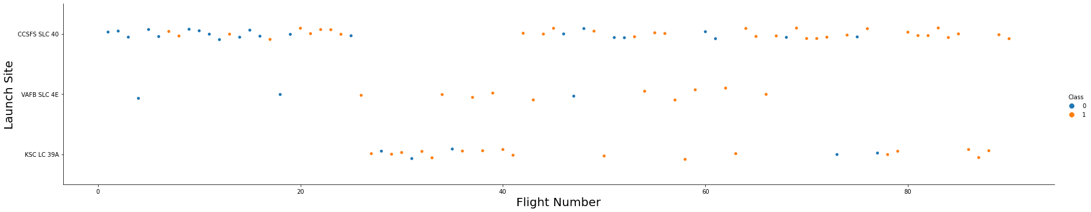
Flight Number vs. Launch Site
Show a scatter plot of Flight Number vs. Launch Site
Scatter plot data is very evenly distributed

Slide 19
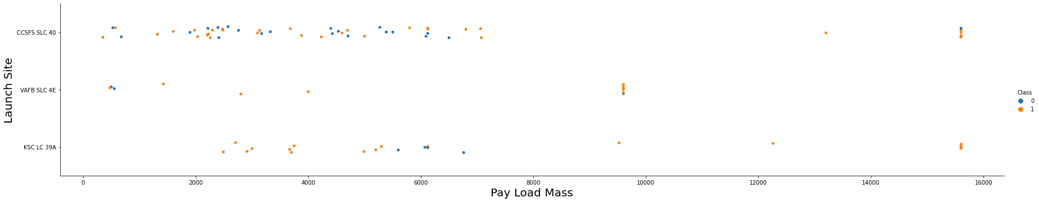
Payload vs. Launch Site
Show a scatter plot of Payload vs. Launch Site
Majority less than 700 Pay Loads

Slide 20
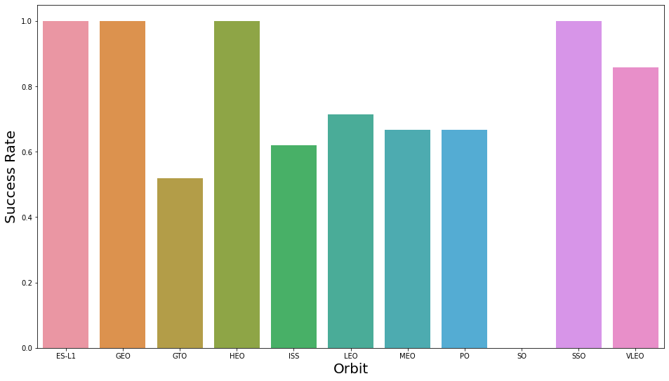
Success Rate vs. Orbit Type
There are 4 equally orbit launched

Slide 21
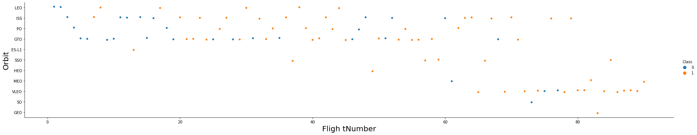
Flight Number vs. Orbit Type
Show a scatter point of Flight number vs. Orbit type
Class 0 and 1 evenly

Slide 22
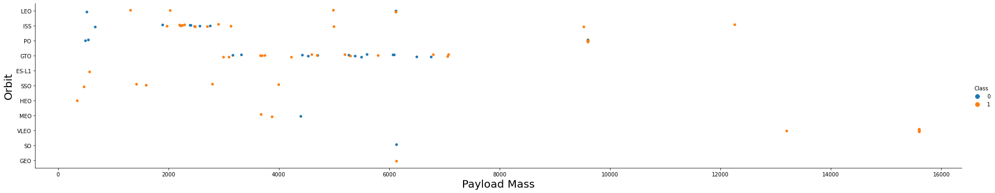
Payload vs. Orbit Type
Show a scatter point of payload vs. orbit type
Payload less than 7000

Slide 23
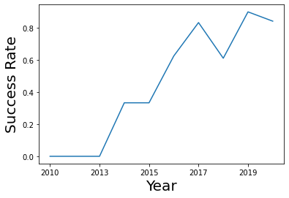
Launch Success Yearly Trend
Show a line chart of yearly average success rate
Each year improved success rate

Slide 24
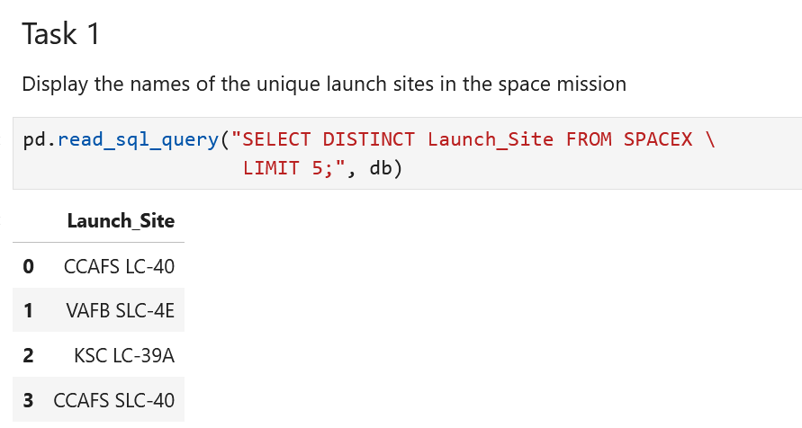
All Launch Site Names
Find the names of the unique launch sites
Present your query result with a short explanation here

Slide 25
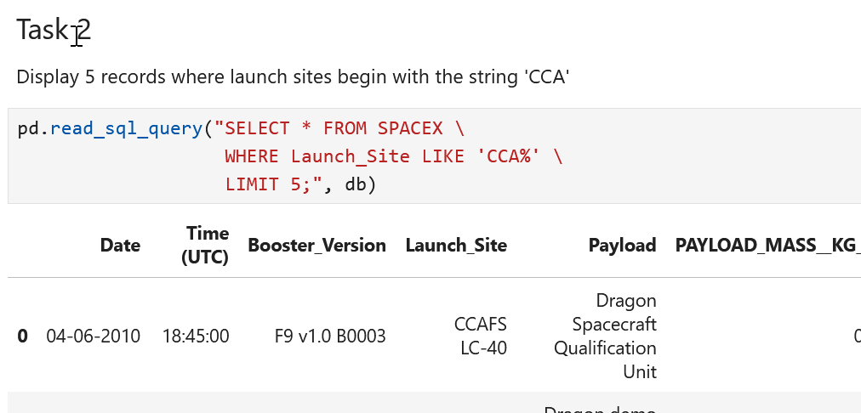
Launch Site Names Begin with 'CCA'
Find 5 records where launch sites begin with `CCA`
Present your query result with a short explanation here

Slide 26
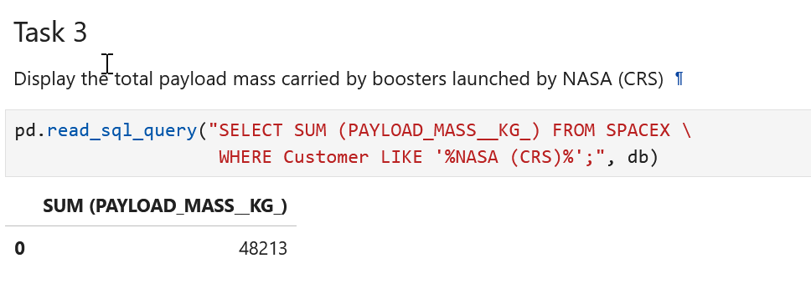
Total Payload Mass
Calculate the total payload carried by boosters from NASA
Present your query result with a short explanation here

Slide 27
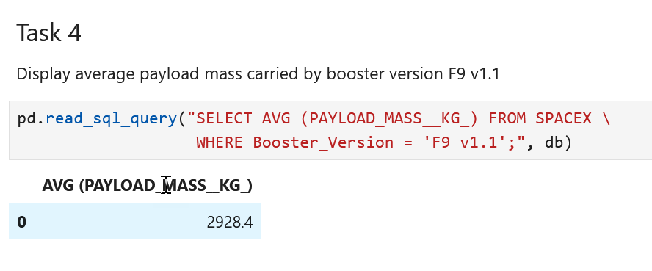
Average Payload Mass by F9 v1.1
Calculate the average payload mass carried by booster version F9 v1.1
Present your query result with a short explanation here

Slide 28
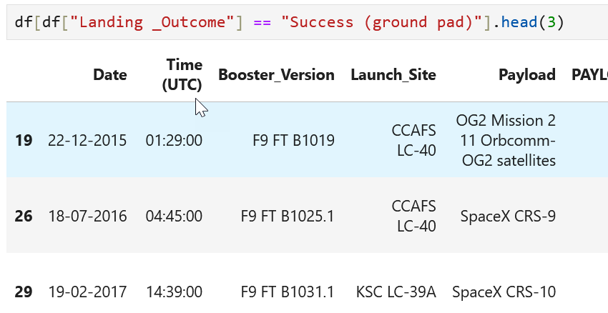
First Successful Ground Landing Date
Find the dates of the first successful landing outcome on ground pad
Present your query result with a short explanation here

Slide 29
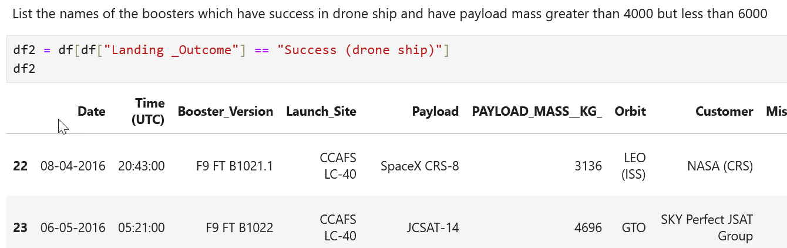
Successful Drone Ship Landing with Payload between 4000 and 6000
List the names of boosters which have successfully landed on drone ship and had payload mass greater than 4000 but less than 6000
Present your query result with a short explanation here

Slide 30
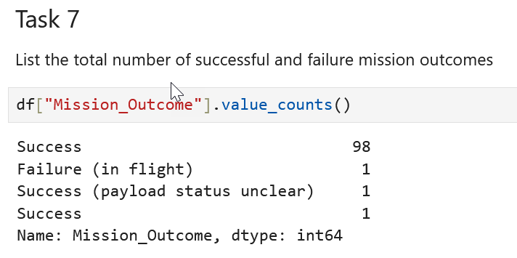
Total Number of Successful and Failure Mission Outcomes
Calculate the total number of successful and failure mission outcomes
Present your query result with a short explanation here

Slide 31
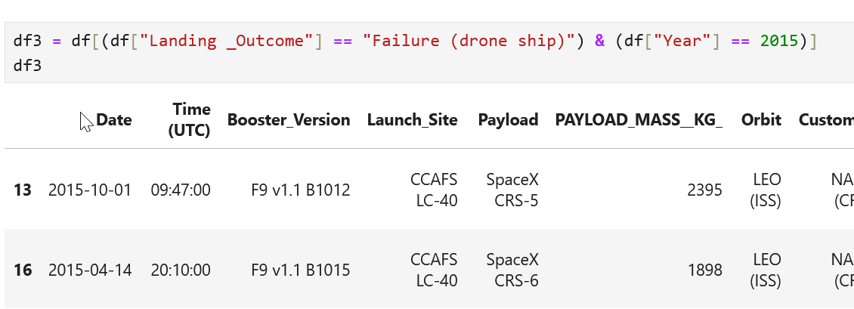
Boosters Carried Maximum Payload
List the names of the booster which have carried the maximum payload mass
Present your query result with a short explanation here

Slide 32
2015 Launch Records
List the failed landing_outcomes in drone ship, their booster versions, and launch site names for in year 2015
Present your query result with a short explanation here

Slide 33
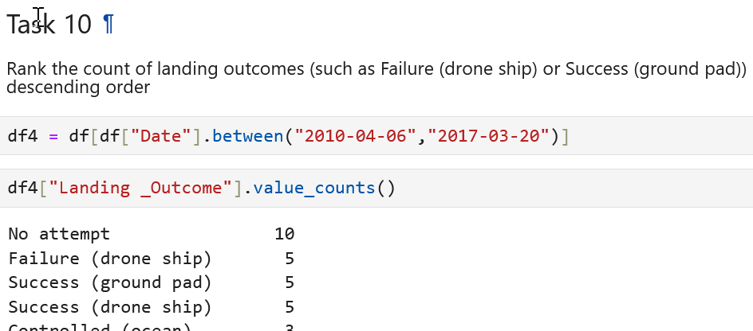
Rank Landing Outcomes Between 2010-06-04 and 2017-03-20
Rank the count of landing outcomes (such as Failure (drone ship) or Success (ground pad)) between the date 2010-06-04 and 2017-03-20, in descending order
Present your query result with a short explanation here

Slide 34

Section 3

Slide 35
<Folium Map Screenshot 1>
Replace <Folium map screenshot 1> title with an appropriate title
Explore the generated folium map and make a proper screenshot to include all launch sites’ location markers on a global map
Explain the important elements and findings on the screenshot

Slide 36
<Folium Map Screenshot 2>
Replace <Folium map screenshot 2> title with an appropriate title
Explore the folium map and make a proper screenshot to show the color-labeled launch outcomes on the map
Explain the important elements and findings on the screenshot

Slide 37
<Folium Map Screenshot 3>
Replace <Folium map screenshot 3> title with an appropriate title
Explore the generated folium map and show the screenshot of a selected launch site to its proximities such as railway, highway, coastline, with distance calculated and displayed
Explain the important elements and findings on the screenshot

Slide 38

Section 4

Slide 39
<Dashboard Screenshot 1>
Replace <Dashboard screenshot 1> title with an appropriate title
Show the screenshot of launch success count for all sites, in a piechart
Explain the important elements and findings on the screenshot

Slide 40
<Dashboard Screenshot 2>
Replace <Dashboard screenshot 2> title with an appropriate title
Show the screenshot of the piechart for the launch site with highest launch success ratio
Explain the important elements and findings on the screenshot

Slide 41
<Dashboard Screenshot 3>
Replace <Dashboard screenshot 3> title with an appropriate title
Show screenshots of Payload vs. Launch Outcome scatter plot for all sites, with different payload selected in the range slider
Explain the important elements and findings on the screenshot, such as which payload range or booster version have the largest success rate, etc.

Slide 42

Section 5

Slide 43
Classification Accuracy
Visualize the built model accuracy for all built classification models, in a bar chart
Find which model has the highest classification accuracy

Slide 44
Confusion Matrix
Show the confusion matrix of the best performing model with an explanation

Slide 45
Conclusions
Point 1
Point 2
Point 3
Point 4
…

Slide 46
Appendix
Include any relevant assets like Python code snippets, SQL queries, charts, Notebook outputs, or data sets that you may have created during this project

Slide 47


